Slide 1
NALLA MALLA REDDY ENGINEERING COLLEGE
Week- 9

Slide 2
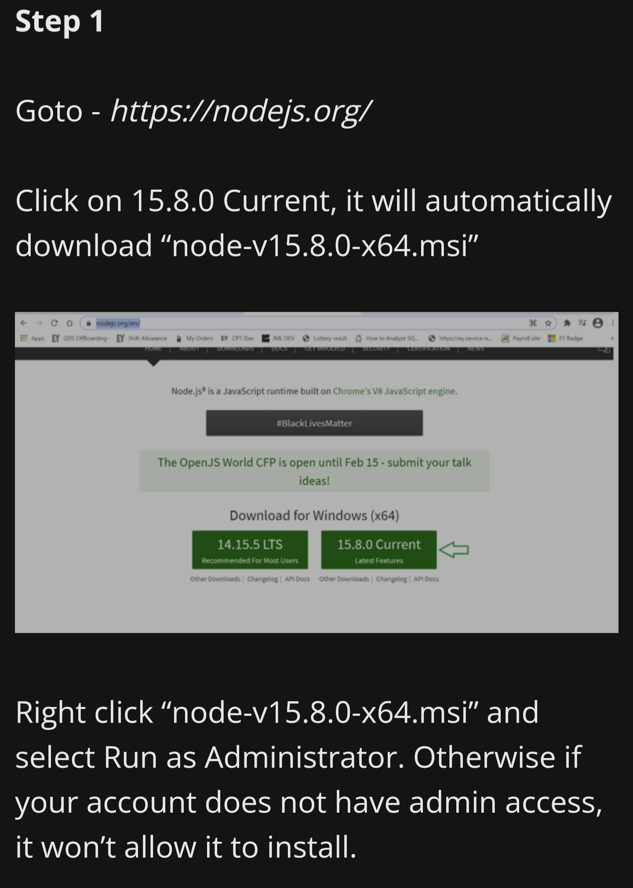
Environment setup and running angular Js application.

Slide 3
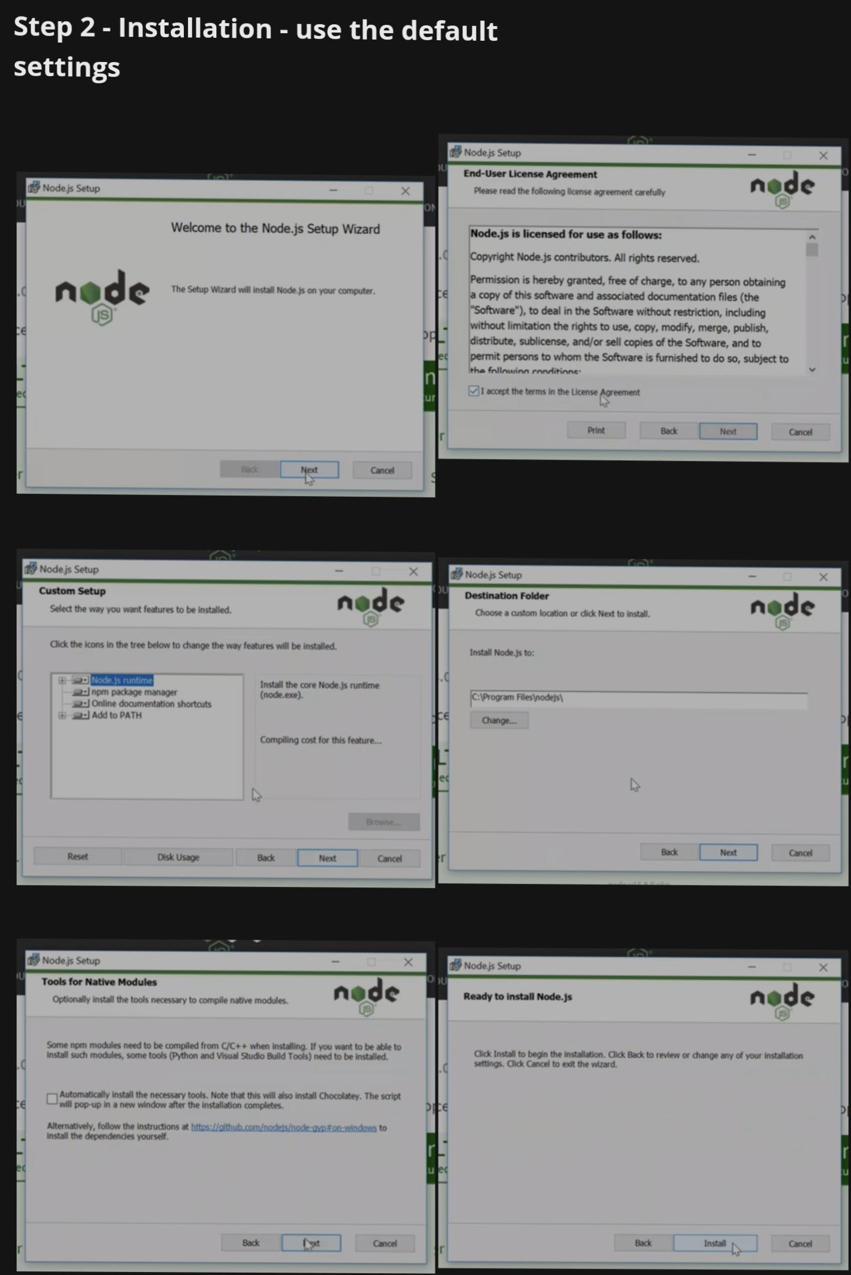

Slide 4
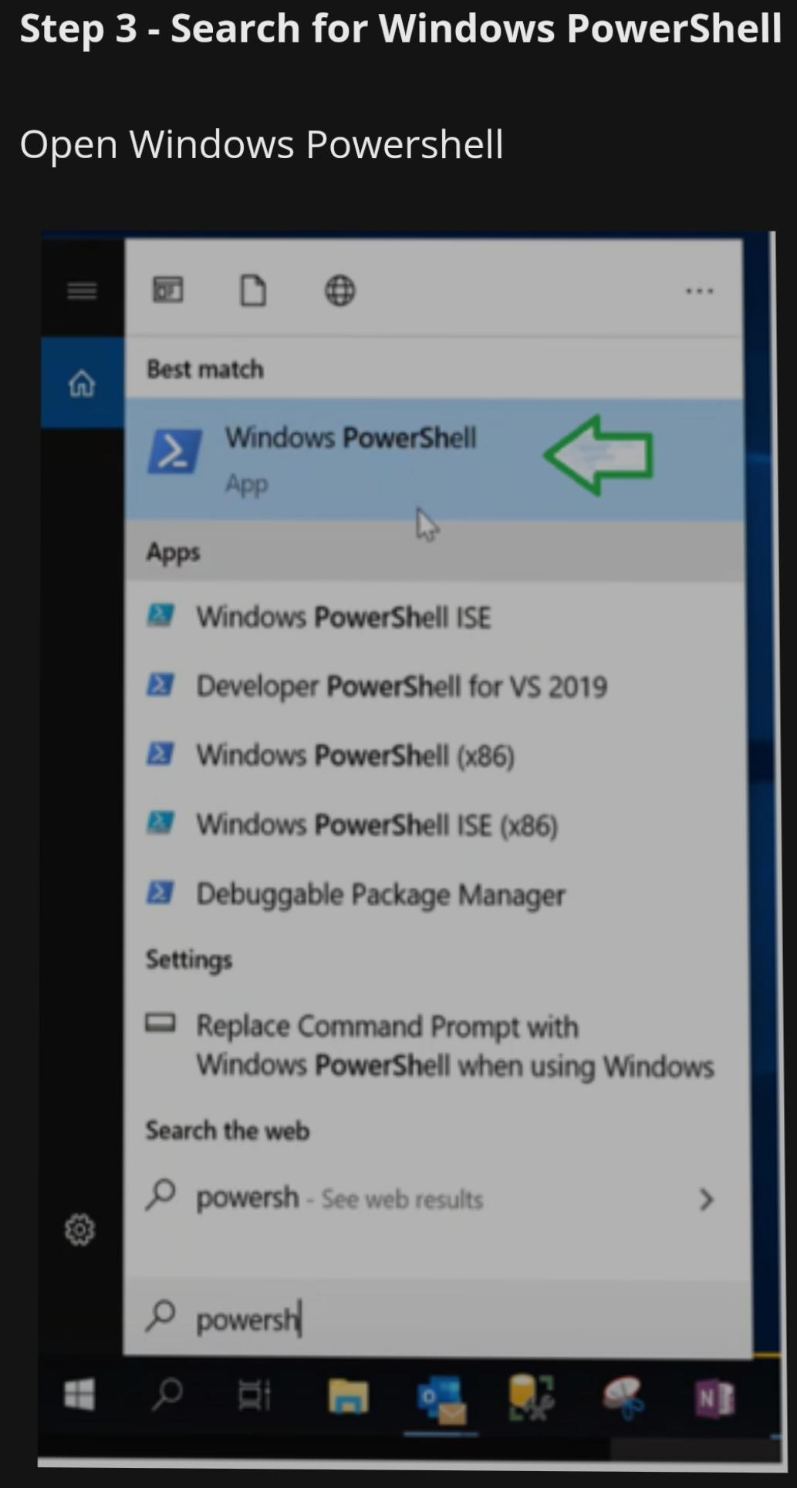
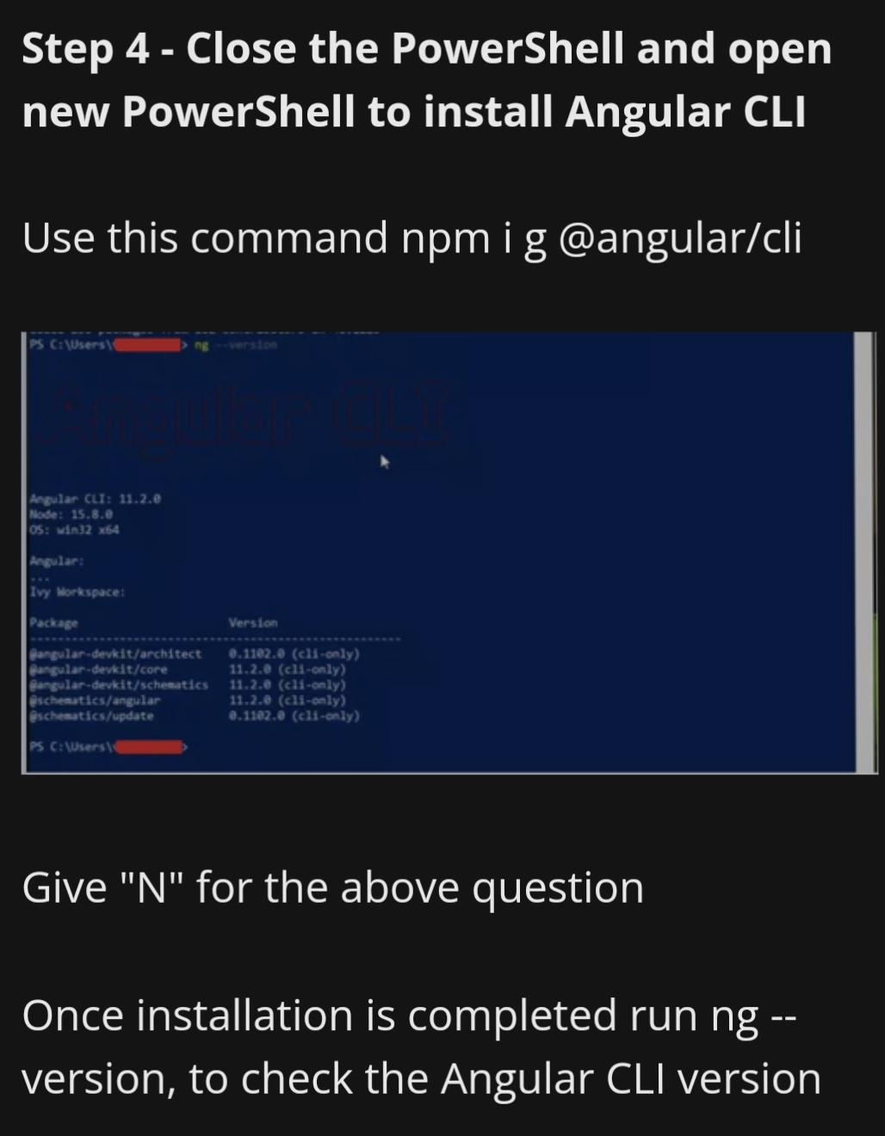

Slide 5
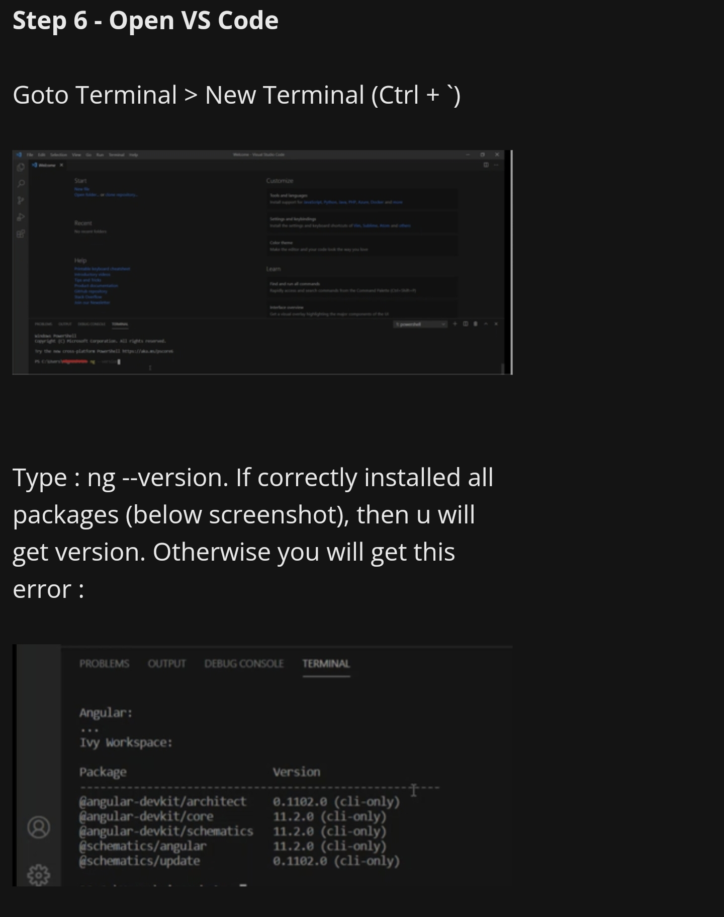

Slide 6
Angular JS
Write AngularJS programs to demonstrate following features:
1. Data-binding
File Name: Db.html <!DOCTYPE html> <html> <script src="https://ajax.googleapis.com/ajax/libs/angularjs/1.6.9/angular.min.js"></s cript> <body> <div ng-app="myApp" ng-controller="myCtrl"> Name: <input ng-model="firstname"> <h1>{{firstname}}</h1> </div> <script> var app = angular.module('myApp', []); app.controller('myCtrl', function($scope) { $scope.firstname = "Angular"; $scope.lastname = "JS"; }); </script> <p>Change the name inside the input field, and the model data will change automatically, and therefore also the header will change its value.</p> </body> </html>

Slide 7
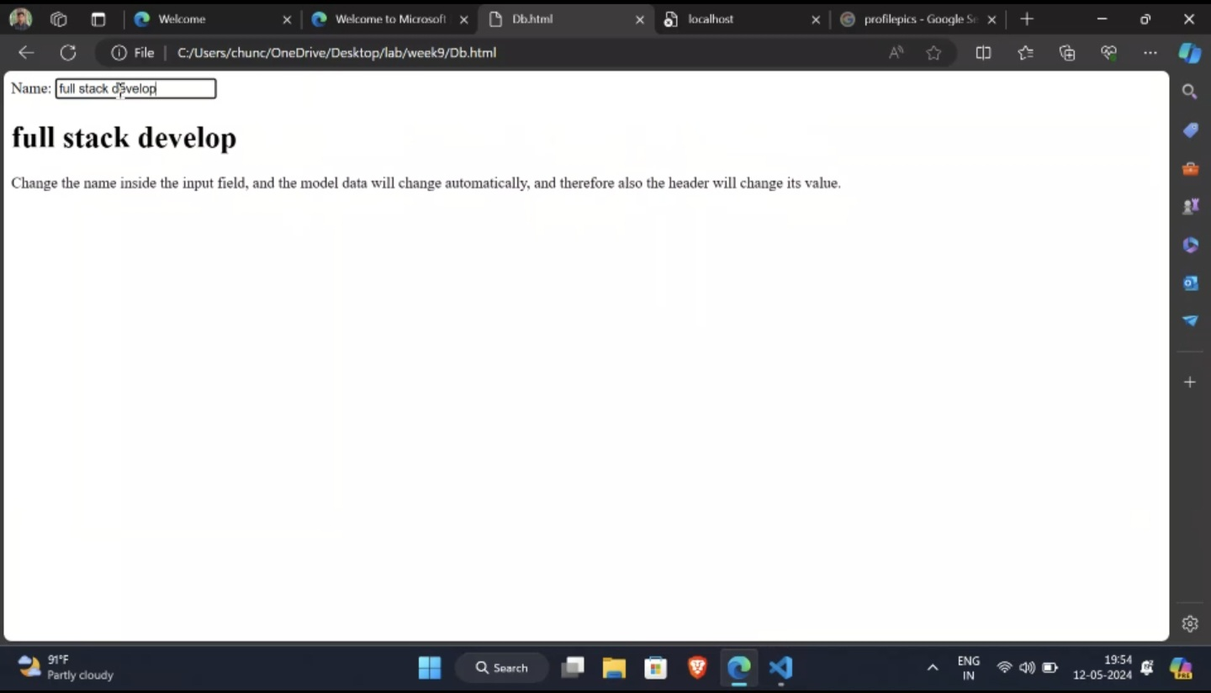
Output

Slide 8
2. Scope <!DOCTYPE html> <html> <script src=“./angular.min.js”> </script> <body> <div ng-app=“myApp” ng-controller=“myCtrl”> <input ng-model=“name”> <h1>Here the sessions is: {{name}}</h1> </div> <script> var app = angular.module(‘myApp’, []); app.controller(‘myCtrl’, function($scope) { $scope.name = “Angular JS”; }); </script> <p>When you change the name in the input field, the changes will affect the model, and it will also affect the name property in the controller.</p> </body> </html

Slide 9
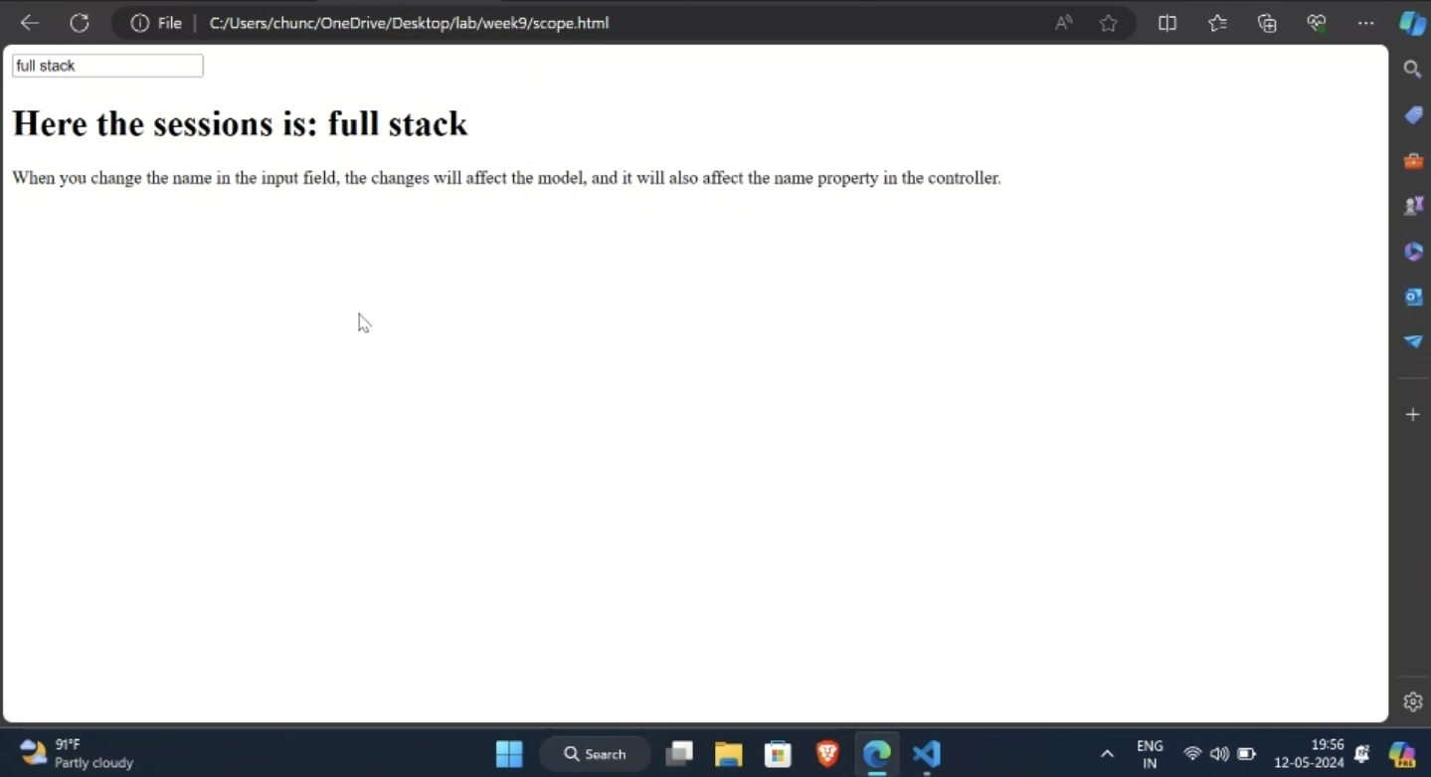
Output

Slide 10
3. Controller <!DOCTYPE html> <html> <script src=https://ajax.googleapis.com/ajax/libs/angularjs/1.6.9/angular.min.js></s cript> <body> <div ng-app="myApp" ng-controller="myCtrl"> First Name: <input type="text" ng-model="firstName"><br> Last Name: <input type="text" ng-model="lastName"><br> <br> Full Name: {{firstName + " " + lastName}} </div> <script> var app = angular.module('myApp', []); app.controller('myCtrl', function($scope) { $scope.firstName = "CSE"; $scope.lastName = "3B"; }); </script> </body> </html>

Slide 11
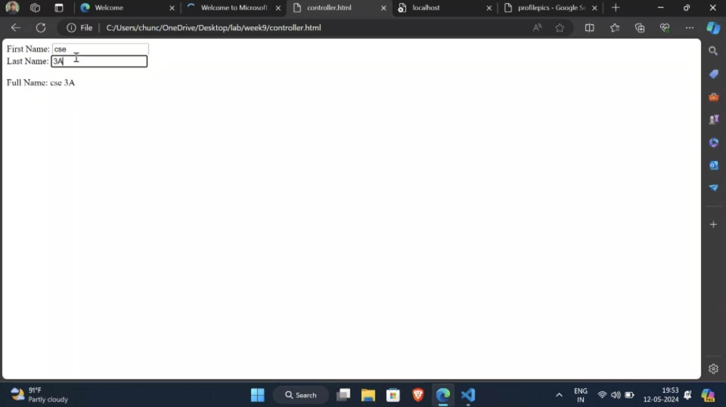
Output

Slide 12
4.Services <!DOCTYPE html> <html> <script src=https://ajax.googleapis.com/ajax/libs/angularjs/1.6.9/angular.min.js></s cript> <body> <div ng-app="myApp" ng-controller="myCtrl"> <p>The hexadecimal value of 210 is:</p> <h1>{{hex}}</h1> </div> <p>A custom service with a method that converts a given number into a hexadecimal number.</p> <script> var app = angular.module('myApp', []); app.service('hexafy', function() { this.myFunc = function (x) { return x.toString(16); } }); app.controller('myCtrl', function($scope, hexafy) { $scope.hex = hexafy.myFunc(210); }); </script> </body> </html>

Slide 13
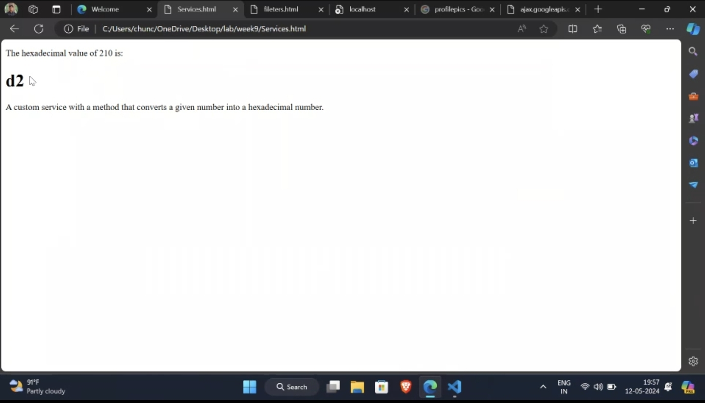
Output

Slide 14
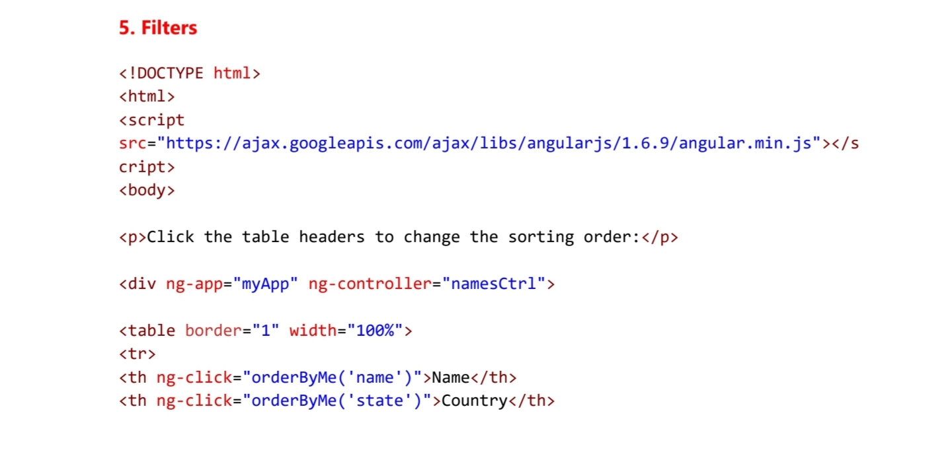
.

Slide 15
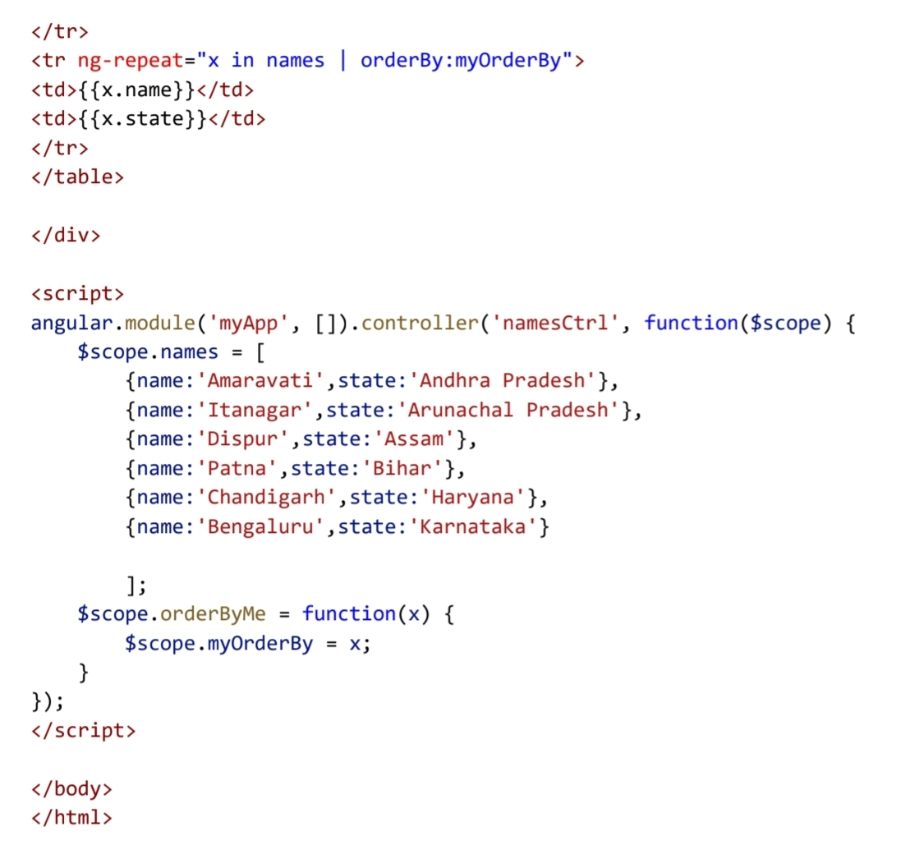

Slide 16
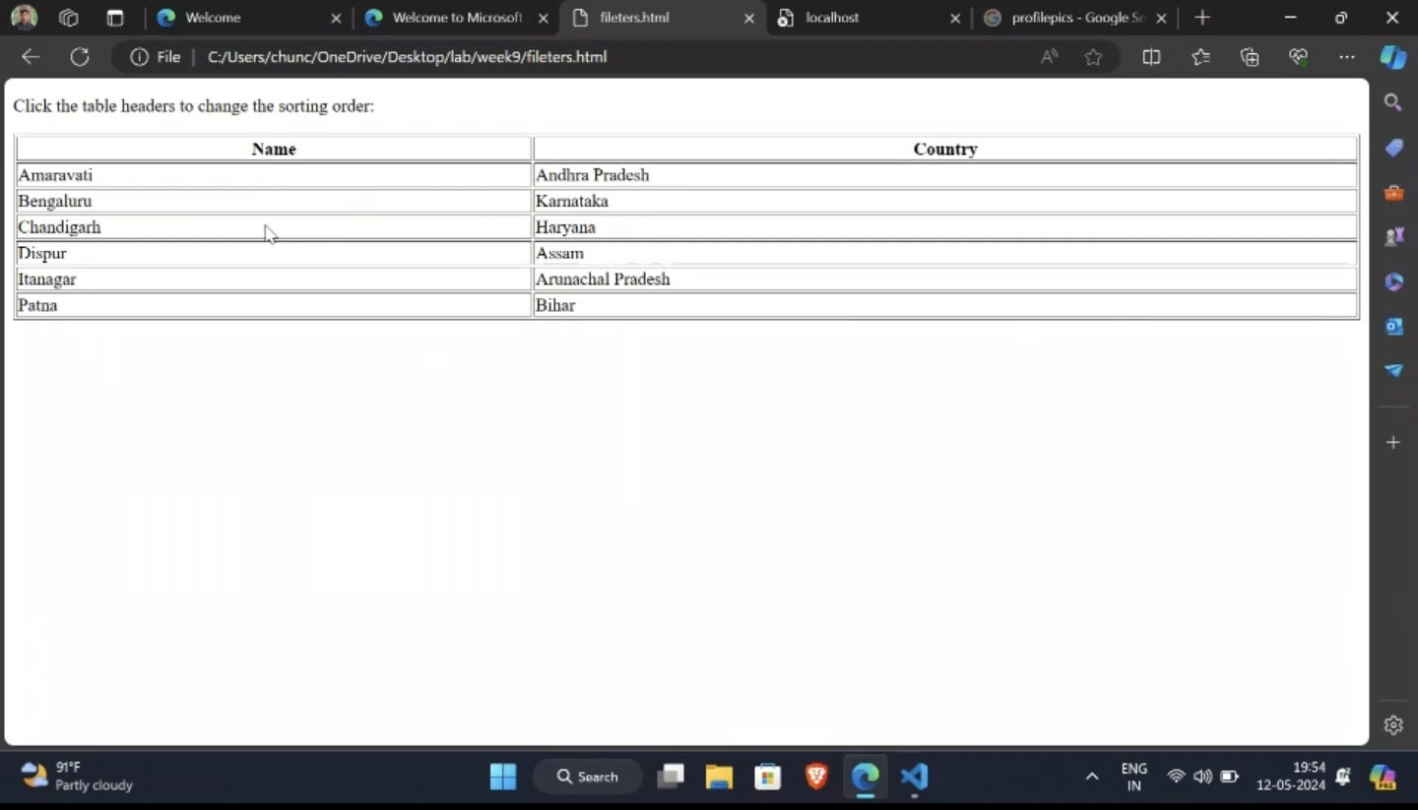
Output

